Slide 1
Dallas County 4-H Veterinary Science Certificate Program Training to prepare for a future career as a Vet Tech May 17, 2018 https://dallas-tx.tamu.edu/

Slide 2
For county updates visit our Website https://dallas-tx.tamu.edu/

Slide 3
Step 1: Join 4-H
Clover Kids: K-2 grades: Limited activities; no contest
4-H Member: 3-12 grades (8 years old before September 1st)
Vet Science Project: Age recommended 12-18 years old.
Adult(s); parents, guardians $10
Highly recommended, if you are not a vetted AgriLife Volunteer you will not be able to participate in events.
Safety Videos – must complete
Background Check required, done by AgriLife during enrollment process
4-H year is September 1 – August 31st
Join at 4-H Connect - If not a member, Recommend waiting until September 2018 https://texas.4honline.com/Login.aspx?403D4079444C6D387A6E595A2F6F3D
Must re-enroll every year - Annual Fee
$20 – September 1st – October 31st
$25 – November 1st for the remainder of the year

Slide 4
Step 2: Create a club - Name
At present, the upcoming group will be none as
The 2018-2019 Class (of Dallas County Vet Science Certificate Program)
Will use this training registration roster for class members
When enrolling
Choose the club you presently are signed up with or
One below
Not enrolled yet, no worries, recommend signing up under
Mesquite 4-H
East Dallas – NEW will be chartered in September
Need to charter a club! – Not necessary but goal for future
Home School
https://aevm.tamu.edu/4-h-veterinary-science/homeschool-program/

Slide 5
Step 3: Attend monthly meetings & 1 field explorations
Monthly meetings must be held
Must have the following
Agenda
Sign In Sheet
Assignment Check
Location of meetings
Option 1 - Central – AgriLife Office
Option 2 - Schedule meetings around the county
Will need your assistance for meeting venue

Slide 6
Veterinary Science Certificate Program https://texas4-h.tamu.edu/projects/veterinary-science/
Age 12 – 18 years of age
8 – 12 years old is the 4-H member requirement, however,
VS Curriculum is high level learning, may discourage young members
Agent has to sign off on all assignments and activities
Check at meetings

Slide 7
Veterinary Science Certificate Program https://aevm.tamu.edu/4-h-veterinary-science/curriculum/
Veterinary Science Certificate Program (handouts)
Upon completion - Classification Veterinary Assistant (VA), receive a certificate from AgriLife Agent (handouts)
3 – 5 years to complete 100 lessons and 500 hours of apprenticeship (handouts)
provides 4-H students with the knowledge and skills necessary to become a veterinary assistant
provides a sound platform for students who wish to pursue an associate, undergraduate, graduate, or professional degree in the veterinary science field
Students who complete the program are eligible for CVA certification through the Texas Veterinary Medical Association (TVMA).
Requires taking a state test - https://www.tvma.org/Certifications/CVA

Slide 8
Agent Expectations
Purchase Curriculum – Possibility of an online curriculum
Text book - $75.00($72.50 + shipping) https://www.agrilifebookstore.org/SearchResults.asp?Search=Veterinary+Science&Submit=Search
You may order your own text book
Attend meetings regularly – Assignment checkoff
Keep a 4-H Recordbook (like a journal) https://texas4-h.tamu.edu/recordbooks/
Awards: County, District and State Level
Scholarships - $$$$$$$$$$$$
Make connections in your city with:
local veterinarians – may be difficult at first, age/liability concern
city animal services (animal shelters)
Pet Stores
Volunteer – Service Learning

Slide 9
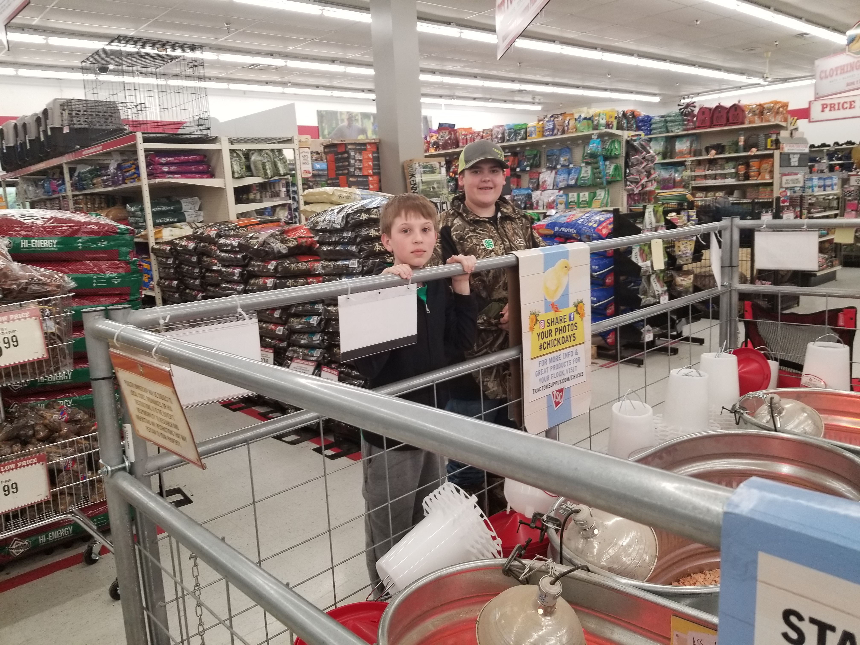
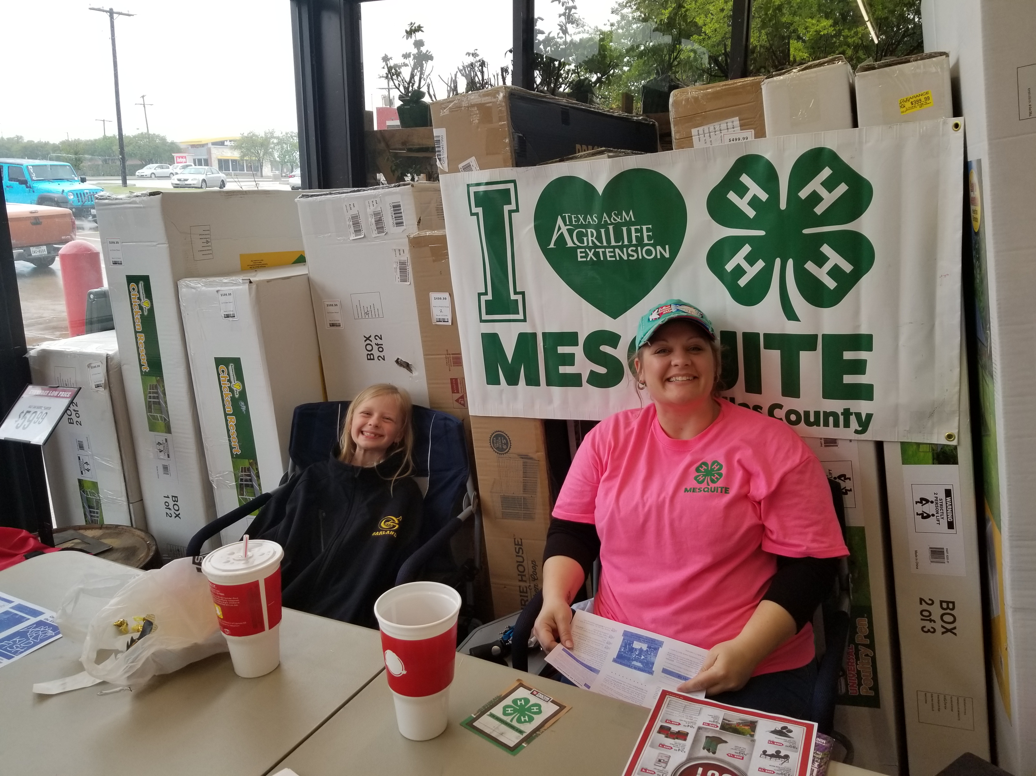
Agent Expectations
Participate in
State 4-H Roundup – at this time the only contest you participate
https://texas4-h.tamu.edu/events/roundup/
Resources: https://aevm.tamu.edu/4-h-veterinary-science/contest-resources/
Written, Skills, PowerPoint Identification
Youth Veterinarian Summer Camp (handout)
https://www.youtube.com/watch?v=erH-e6Lmx9c
Work the Tractor Supply Company Clover Campaign to earn scholarship to attend.
Invitational Contests
State Wide 4-H, Counties will host an invitational, Agent gets notices and passes along
Houston Livestock Show - https://rodeohouston.com/
Heart of Texas - Waco https://www.hotfair.com/events/2018/livestock-show

Slide 10
Let’s get started
Meeting dates?
Locations?

Slide 11
Elizabeth Rudd
Ag & Natural Resources (ANR) CEA
Texas A&M AgriLife Extension Service
Dallas County
10056 Marsh Lane, Suite B-101
Dallas, TX
214-904-3056
elizabeth.rudd@ag.tamu.edu

