Slide 1
Proper Pruning
Presented by Steve Houser
Certified/Consulting Arborist
ISA Certified Arborist, TX #0107
Certified Texas Master Gardener, Dallas County

Slide 2
Dallas County Master Gardener Association

Slide 3
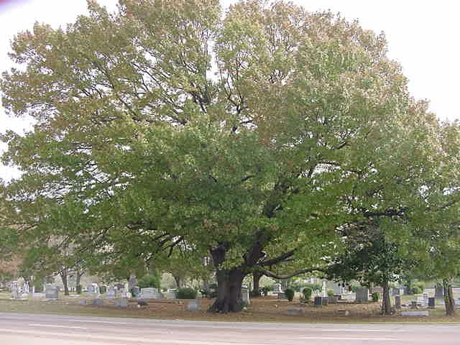
Reasons to Prune
Prune only when necessary, and for a specific purpose
Improving aesthetics and removal of dead limbs
Improving health
Removal of storm damage
Raising low limbs

Slide 4
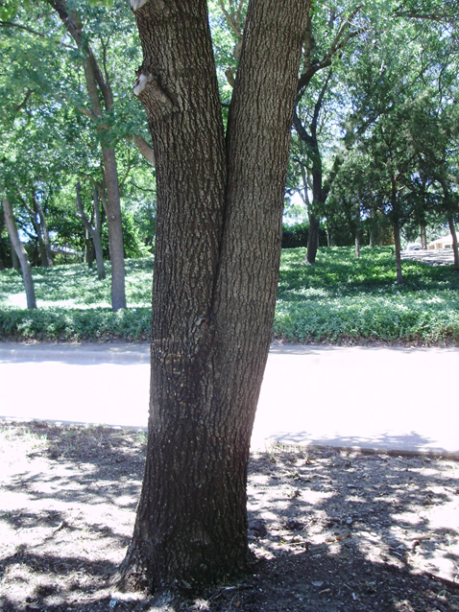
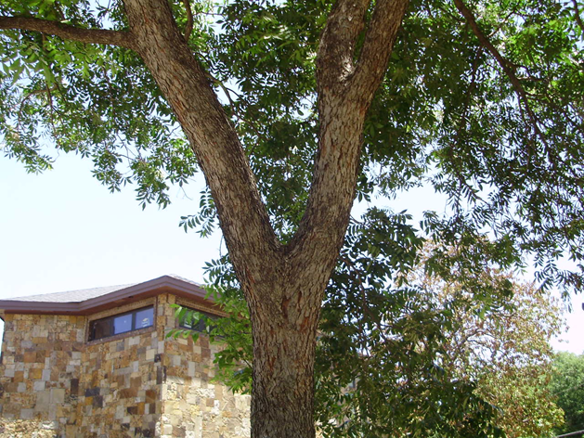
Reasons to Prune
Promotes strong branching unions by correcting structural deficiencies which can lead to structural failure as well as potential liability.
Left: V-shaped- weak branching union
Above: U-shaped- strong branching union

Slide 5
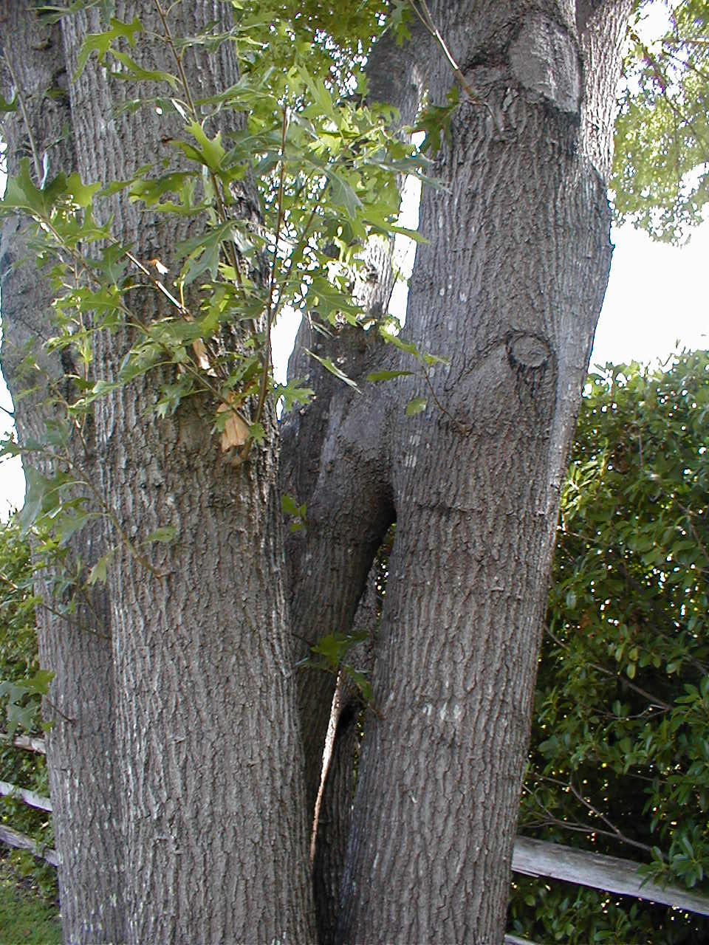
Reasons to Prune
Reducing or preventing co-dominant stems on shade trees.

Slide 6
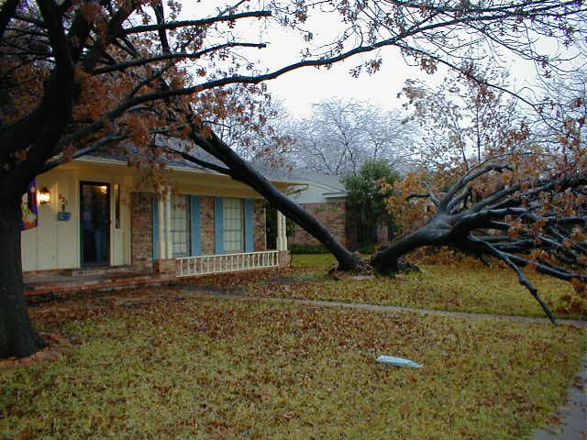
Reasons to Prune
Co-dominant stems often fail as they get larger.

Slide 7
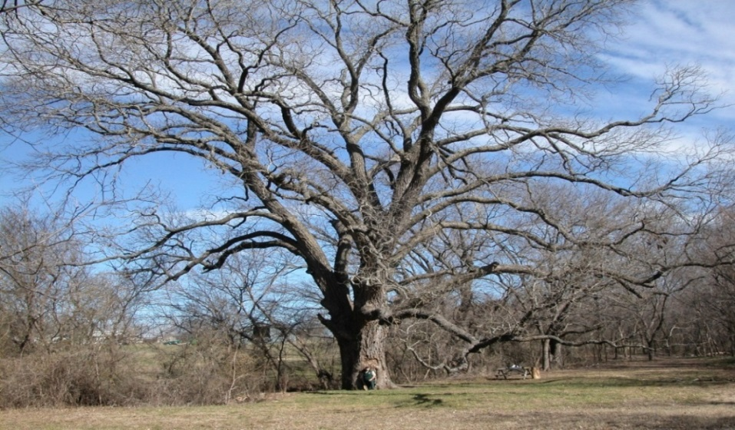
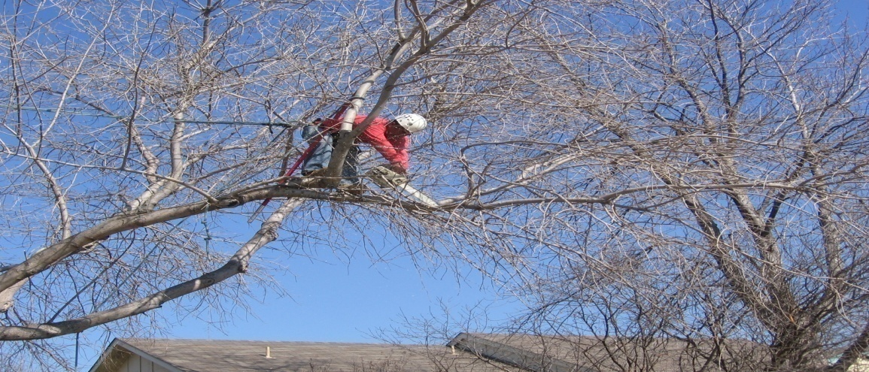
Reasons to Prune
Reduces hazard and liability potential, in part, by reducing the weight on longer limbs, especially fruit and nut producers.

Slide 8
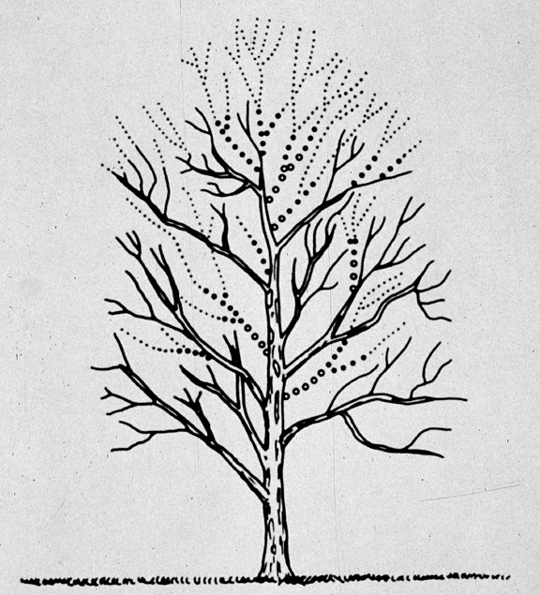
Reasons to Prune
Control the size, or growth form by reducing the size
Typically required due to the wrong tree in the wrong location

Slide 9
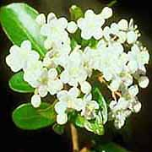
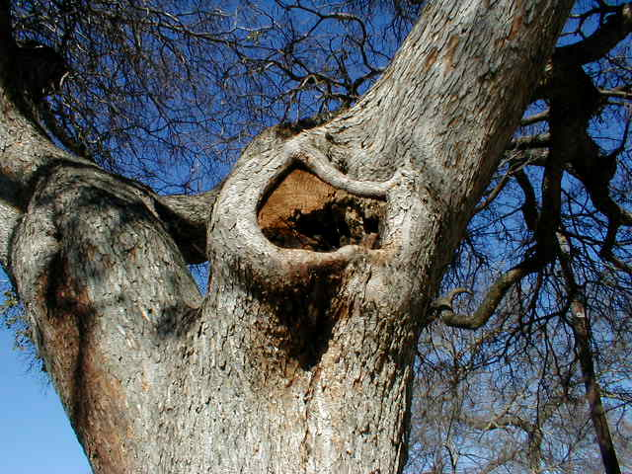
Reasons to Prune
Positive influence on fruit, nut, or flower production
Directs growth according to needs
Other legitimate reasons exist, such as offsetting damaged roots or decay in a limb or trunk

Slide 10
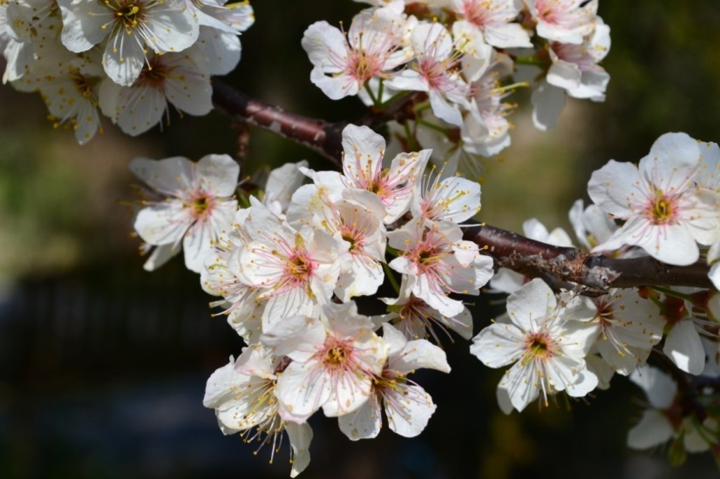
When to Prune
Since flowers grow from buds formed late in the growing season on most shade and ornamental trees, if you want a good show of flowers, wait to prune until after they bloom
Prune maples, walnuts and birch during the growing season, if possible, to avoid sap oozing from the cuts

Slide 11
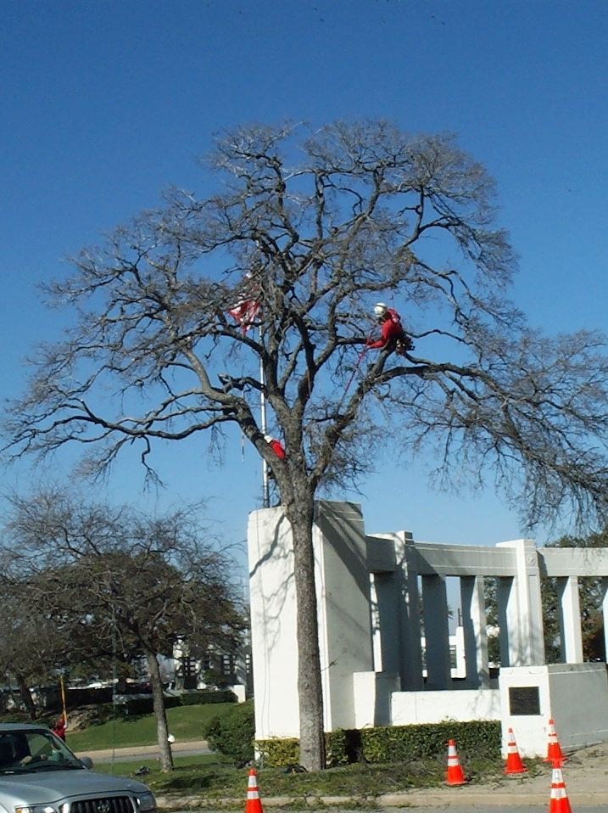
When to Prune
Oaks and other species can be pruned throughout the year as long as it is done properly and precautions are taken regarding all potential pathogens.

Slide 12
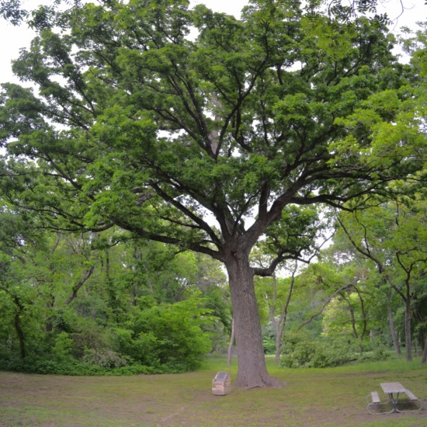
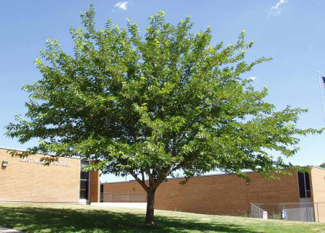
How Often to Prune?
Most all moderate to slow growing species such as oaks, elms, or ash can be pruned every 3-5 years as they age
Faster growing species such as mulberry, cottonwood, or willow may need to be pruned every year when they're young, and every 2-4 years as they age

Slide 13
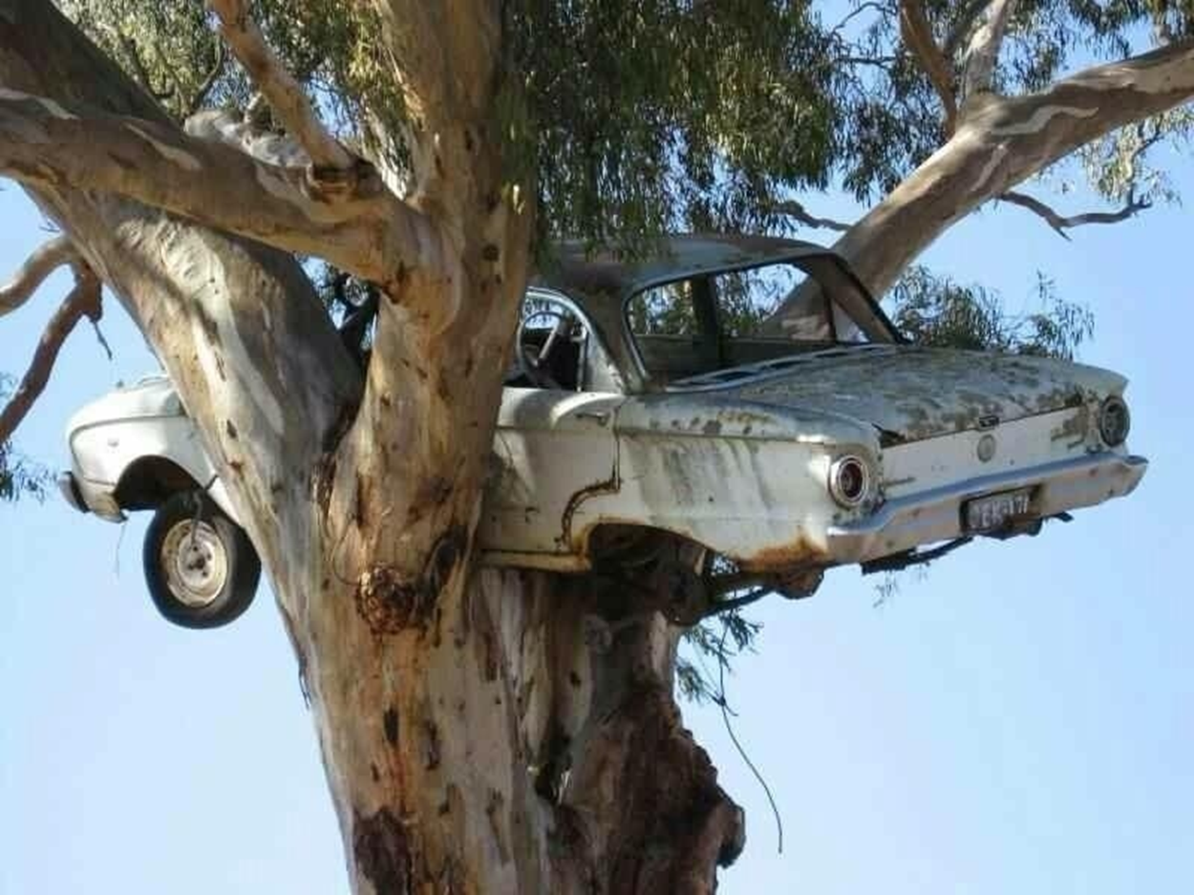
Trees can be a great place for old falcons to rest!!

Slide 14
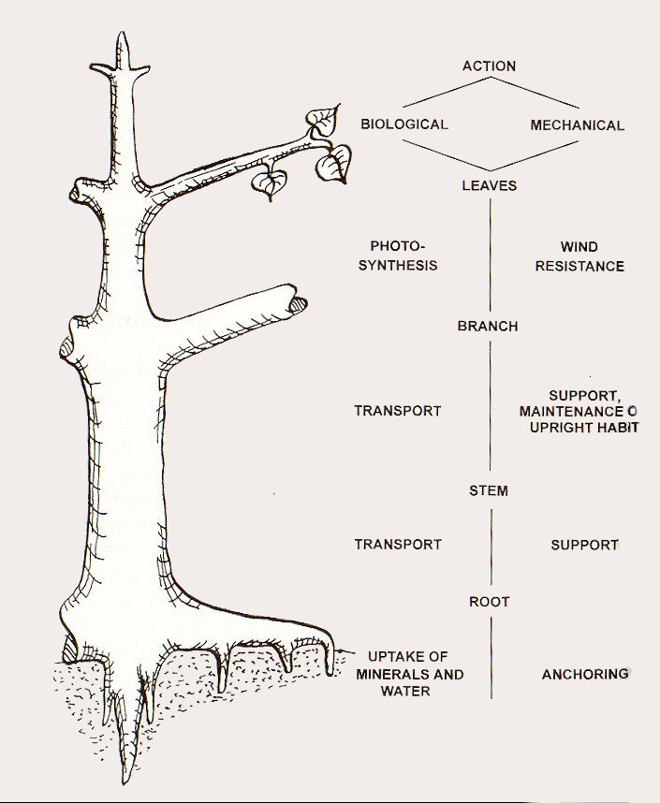
Basic Tree Physiology
All parts of a tree have both a biological as well as a mechanical function.
Trees have a natural mechanical design and any pruning must work with…rather than against the design (feather).

Slide 15
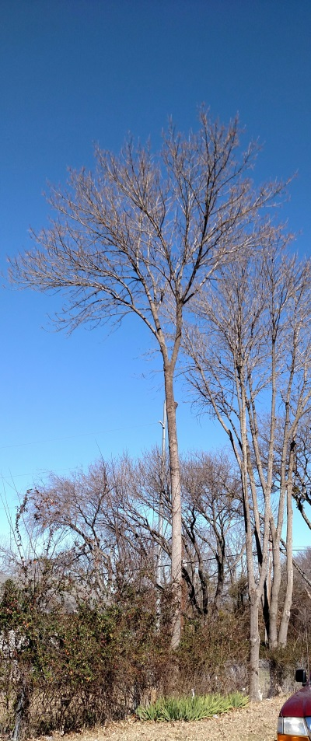
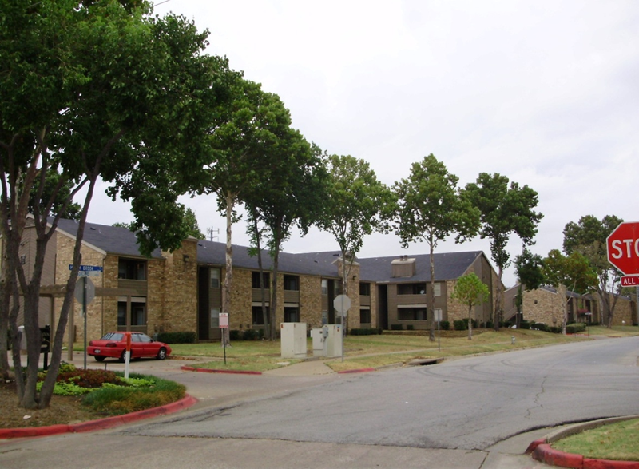
Tree Physiology
Foliage produces food for the plant through photosynthesis with the sun.
Avoid removing more than 20-25% of the foliage in any given year.

Slide 16
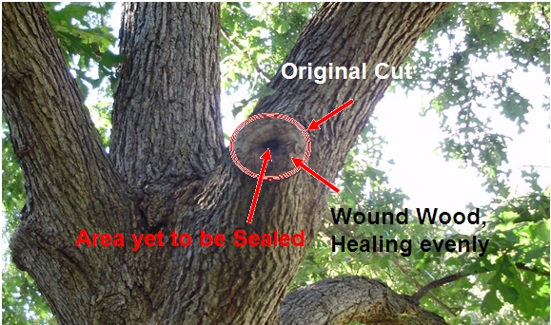
Tree Physiology
Each cut is a wound that must heal.
Trees compartmentalize, or grow over a cut wound from all sides.

Slide 17
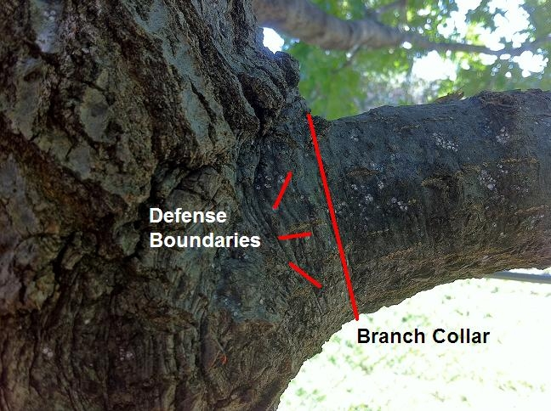
Tree Physiology
Trees have a natural defense boundary that should not be damaged.
The final cut should be made at the branch collar.

Slide 18
My office manager sent me this…
New cell phone for Chivo…

Slide 19
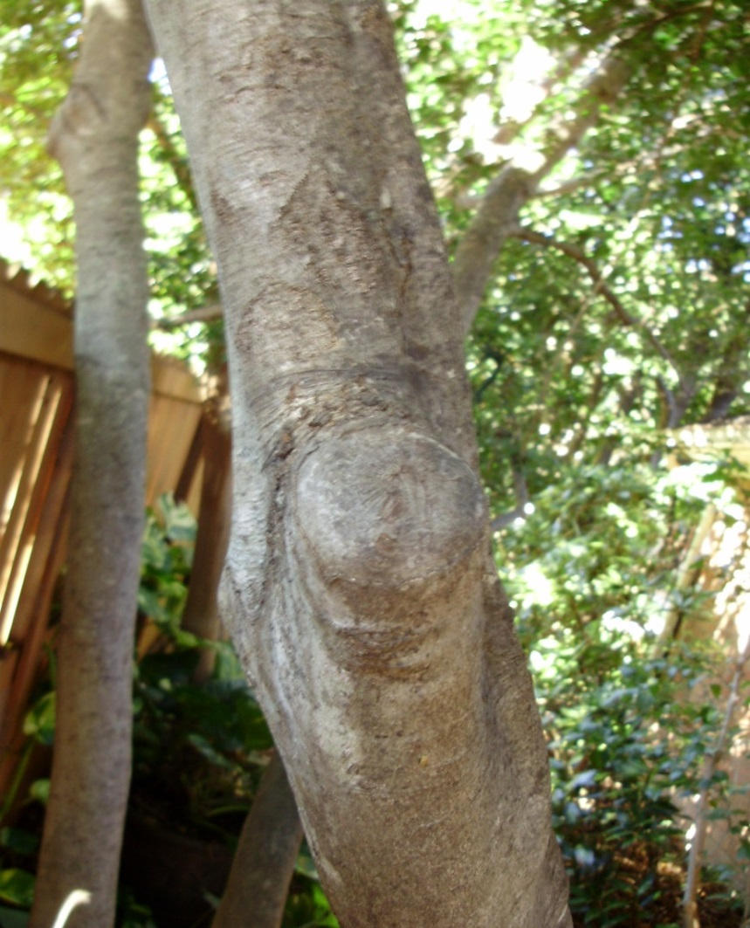
Tree Physiology
A proper cut made at the branch collar compartmentalizes evenly on all sides.
Proper cuts are the trademark of an expert and a good way to tell the good from the bad.

Slide 20
Trees Love Proper Cuts!!

Slide 21
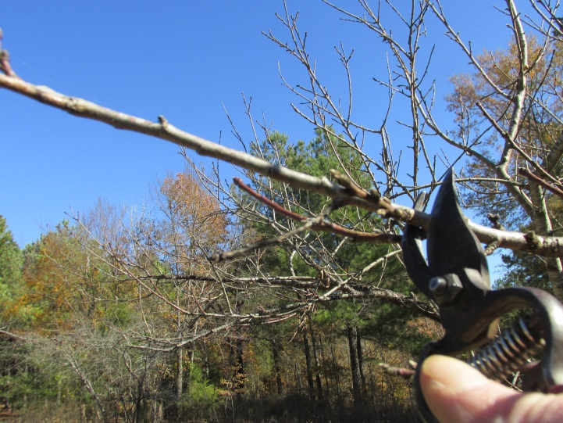
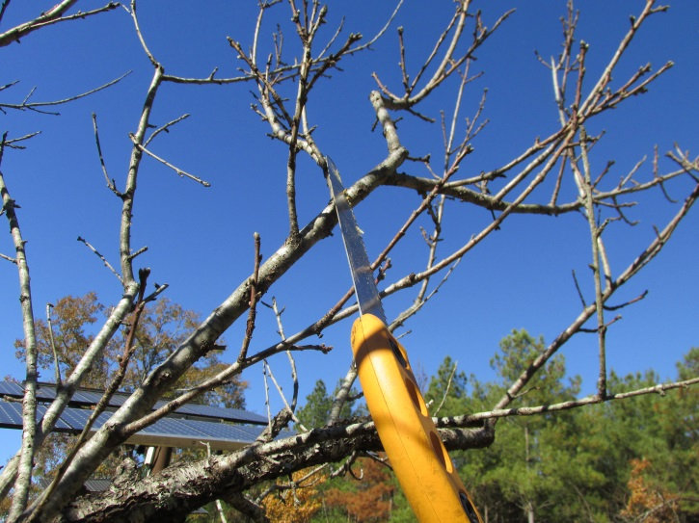
Tree Physiology
Small cuts made throughout the life of a tree are better than large cuts made too late in life
Small wounds compartmentalize quicker than large wounds
Some species are very poor at compartmentalizing wounds (sugarberry)

Slide 22
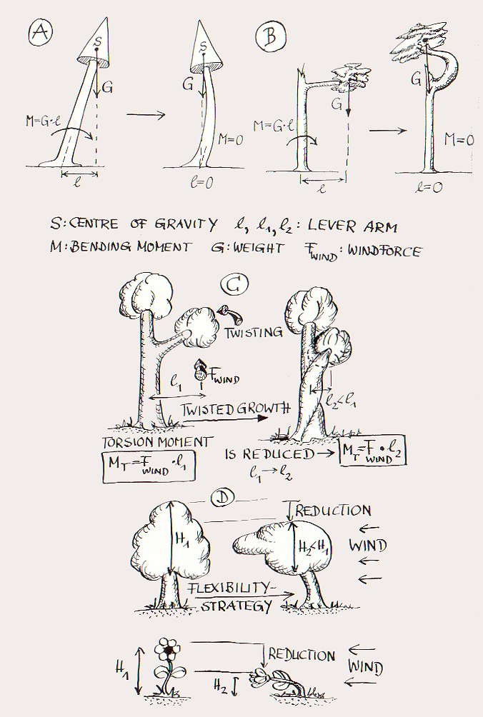
Tree Mechanics
Trees are not static… they are dynamic.
Prof. Claus Mattheck, axium of uniform stress.

Slide 23
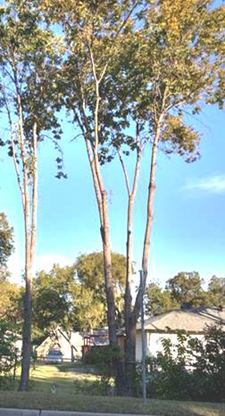
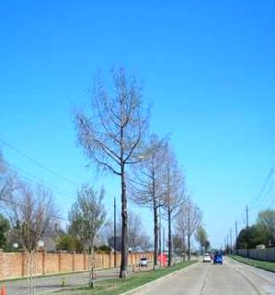
Tree Mechanics
Raising low limbs over a third of the tree’s height greatly increases the odds of structural failure.
It also has a negative effect on its health because a third of the foliage is missing.

Slide 24
Ever see a dog that thinks he’s… a squirrel?
Photo by Natalie Stevens

Slide 25
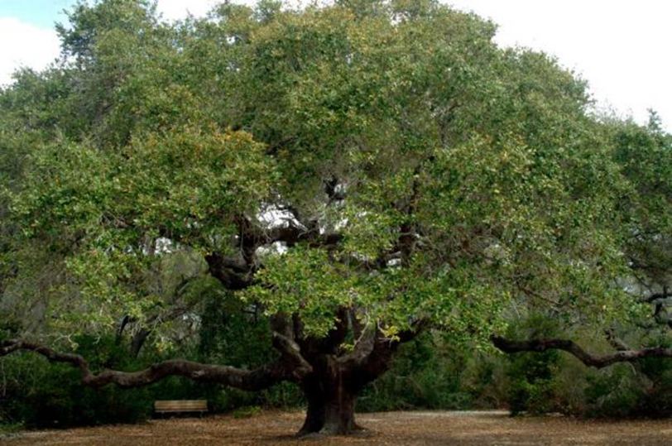
Tree Growth Forms
There are many different growth forms of shade and ornamental trees. Each may require a different type of pruning.
The Live oak has a broad spreading & low branching habit.

Slide 26
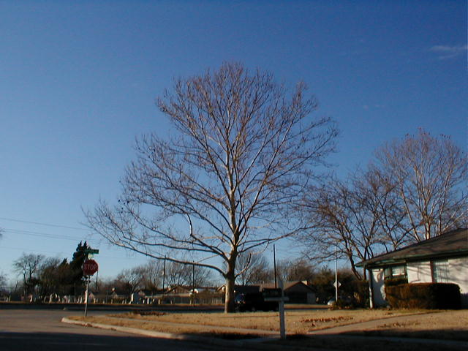
Tree Growth Forms
A sycamore will have an upright branching habit and it is tall, with a strong central leader.
This is known as an “excurrent” form.

Slide 27
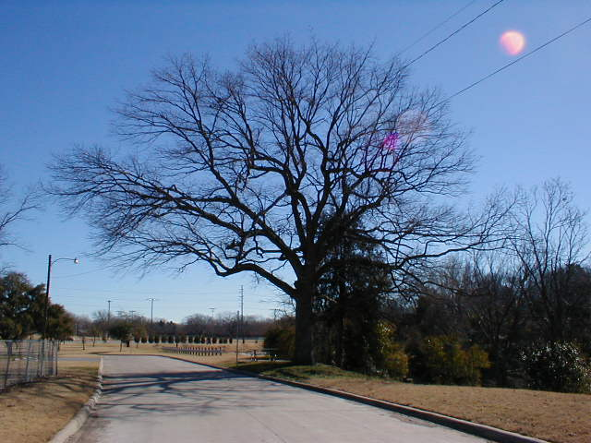
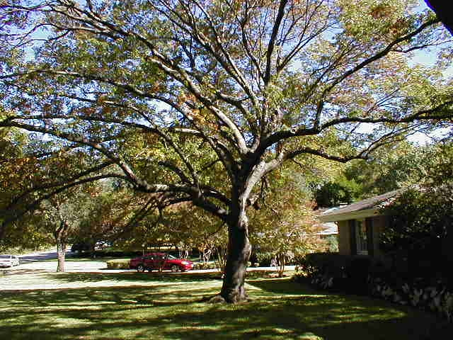
Tree Growth Forms
A Texas red oak will be short and broad spreading with a great amount of lateral growth.
This is known as a “decurrent” form.

Slide 28
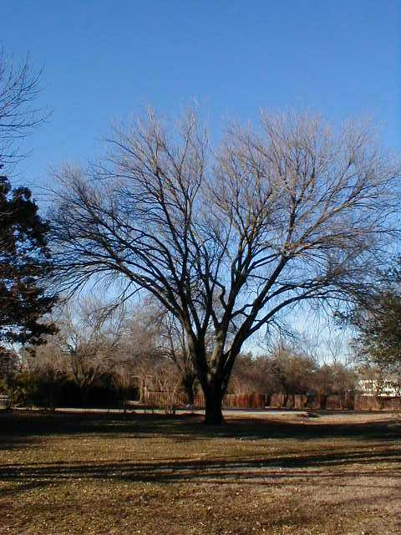
Tree Growth Forms
An American elm has a “vase” shaped growth form, which often leads to a weak branching habit.

Slide 29
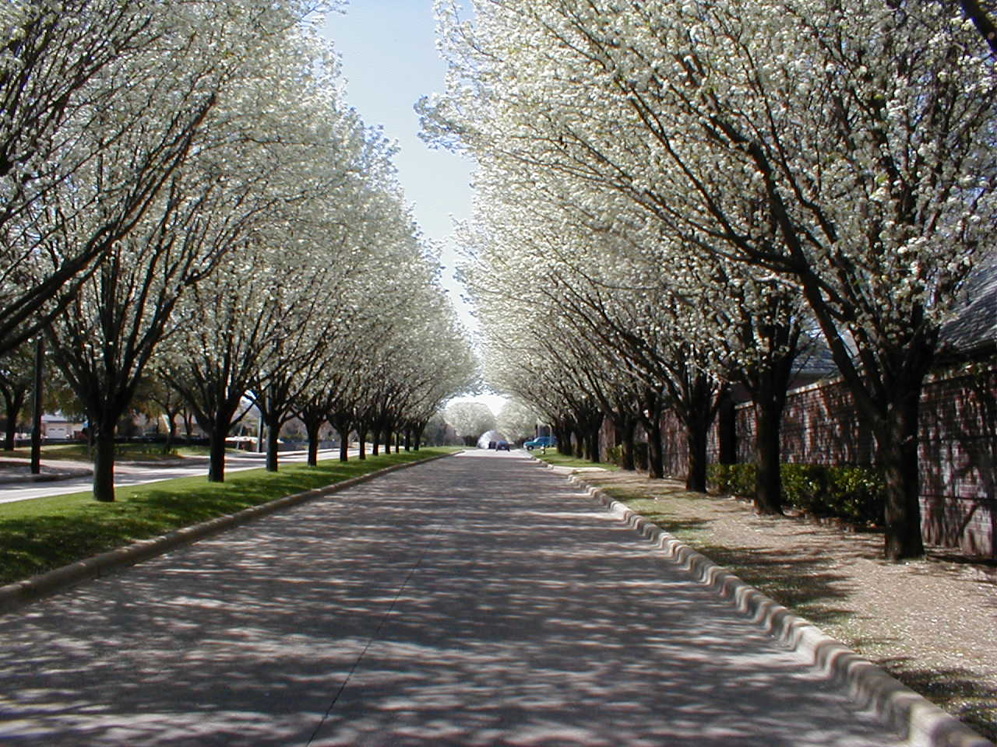
Tree Growth Forms
All growth forms are genetic, with some being predisposed to structural failure.

Slide 30
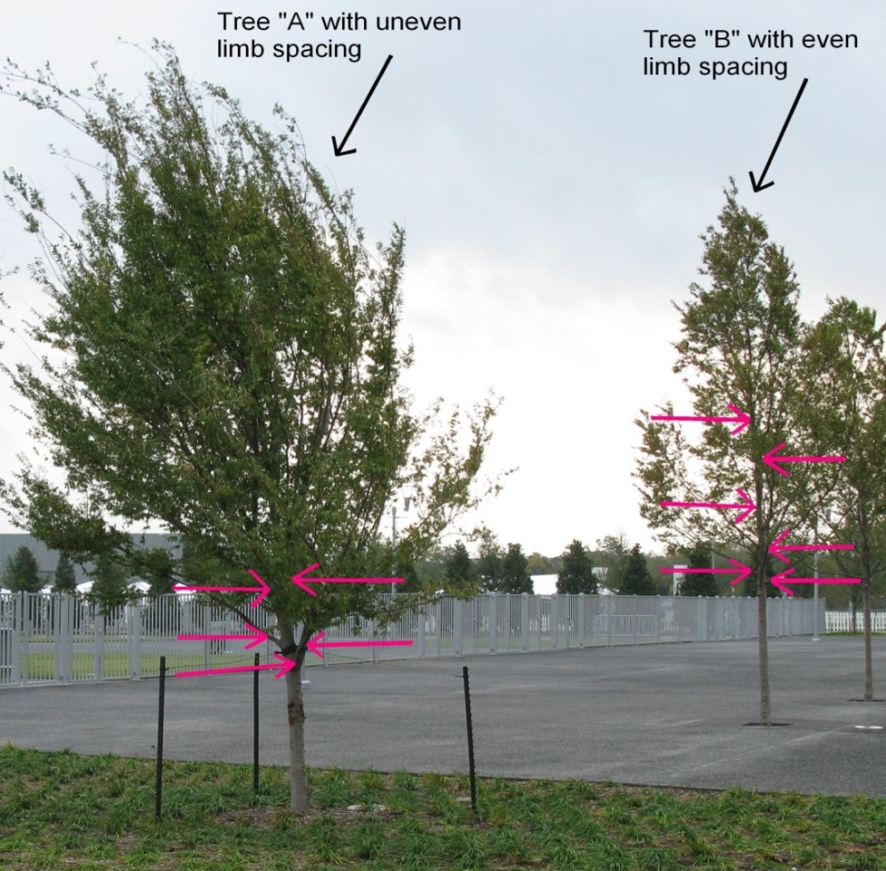
Tree Growth Forms
Even limb spacing or distribution along the trunk is important to reduce structural failure and to equalize the stress from high winds or ice and snow accumulation.

Slide 31
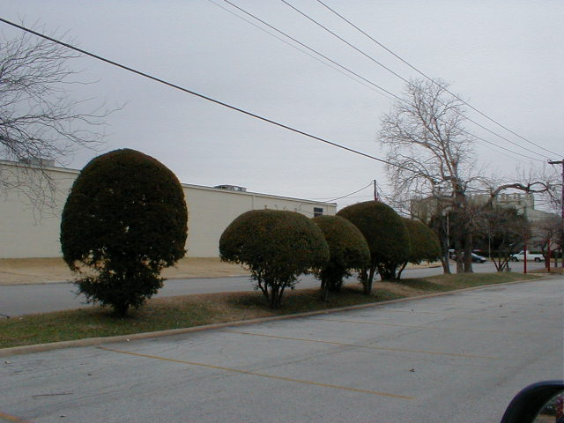
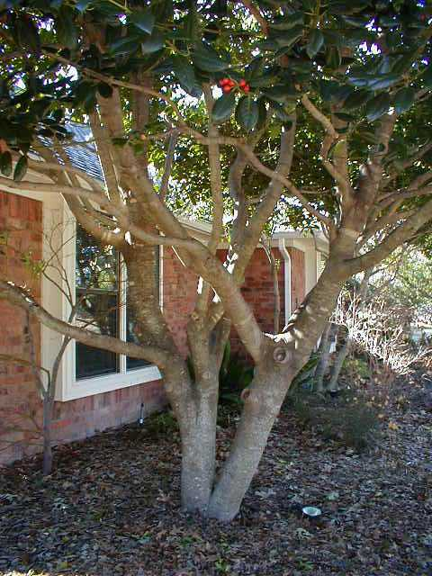
Tree Growth Forms
Smaller ornamental trees and bushes have various growth forms that allow pruning in a tree or bush form (rounded or shaped).
Bush form pruning requires a very hardy plant as it is more difficult to keep the plant healthy.

Slide 32
Tree Growth Forms

Slide 33
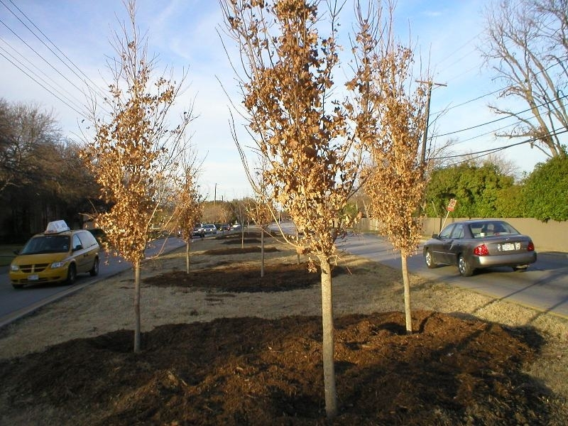
Pruning Types
The type of pruning required depends not only on the growth form but also several other factors, including age.
A recently planted tree requires minimal pruning for a number of years and then structural pruning to separate the limbs.

Slide 34
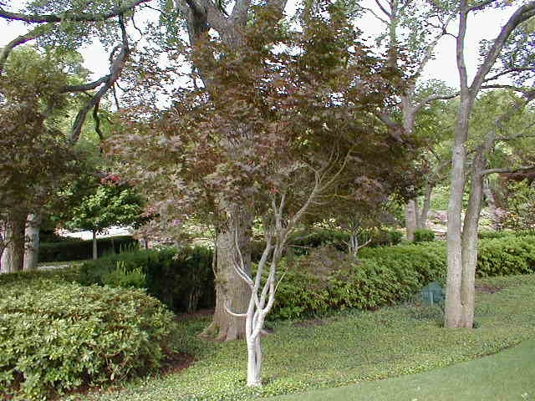
Pruning Types
A young tree must also have weak unions removed to prevent major structural deficiencies as the limbs get large and very heavy.

Slide 35
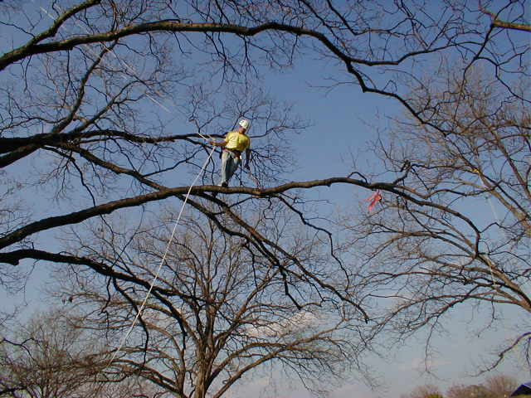
Pruning Types
The species of tree will also determine the type of pruning required.
A nut producer such as pecan, oak, or walnut must have weight reduced on longer limbs as they age.

Slide 36
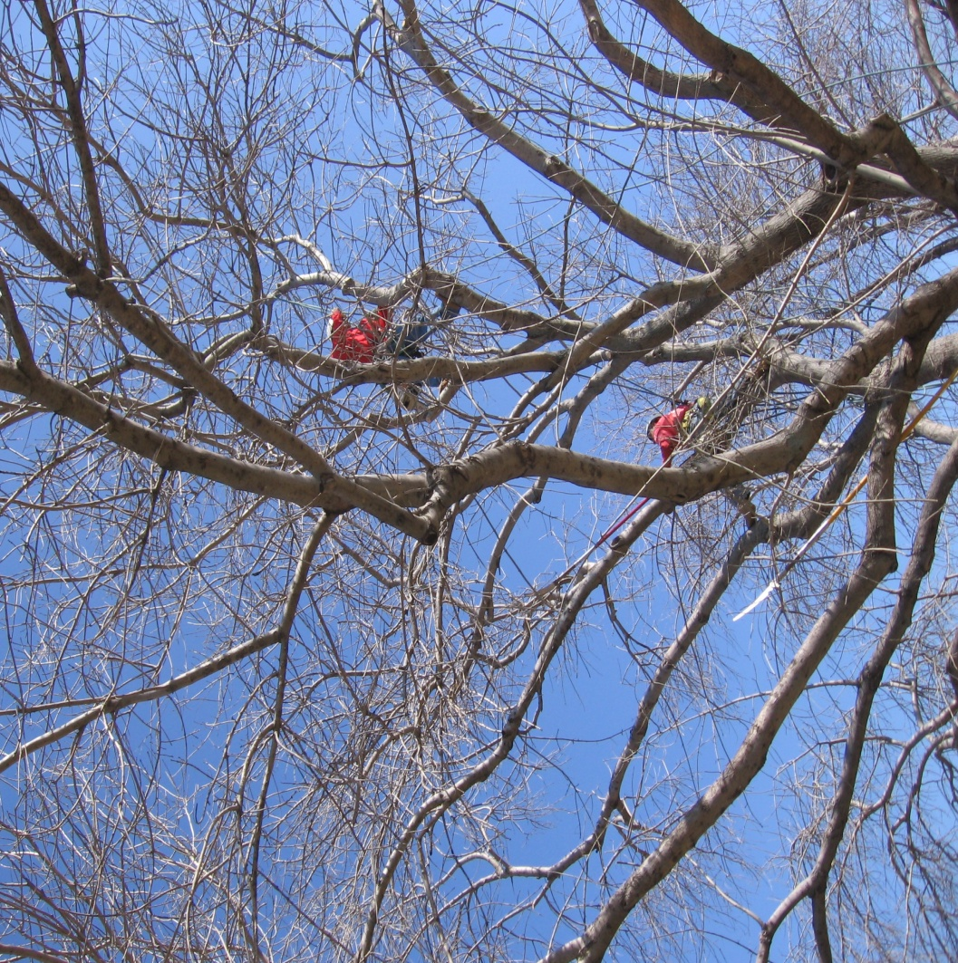
Pruning Types and Terminology
End weight reduction…
arborists should always note this very critical type of pruning for larger, older trees.

Slide 37
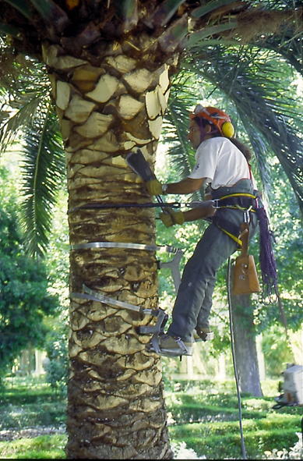
Pruning Types
Fruit trees grown to produce edible fruit are pruned in a completely different fashion than shade or ornamental trees.
This type of pruning, along with palms and crepe myrtles, is not covered in this presentation.

Slide 38
Pruning Types
Pruning to offset root loss
It’s not nice to fool with Mother Nature…

Slide 39
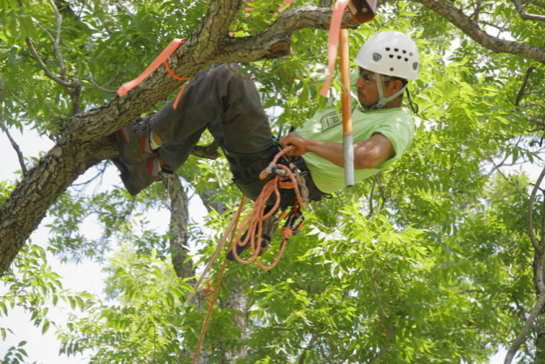
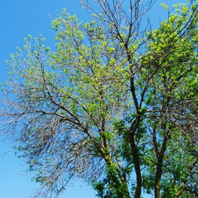
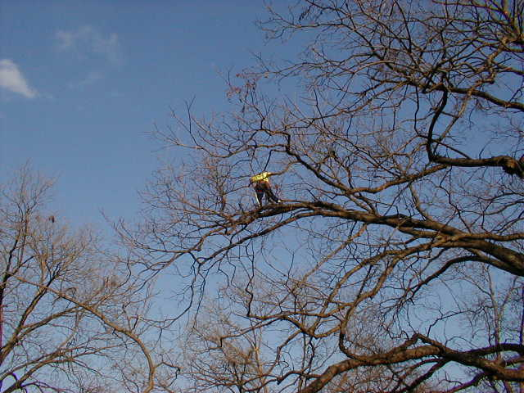
Pruning Types and Terminology
Industry terminology for pruning types varies greatly, but a primary standard is class 1, 2, and 3.
Class 3 is the removal of large deadwood or broken limbs
Class 2 is the removal of medium deadwood, broken limbs, and larger structural pruning

Slide 40
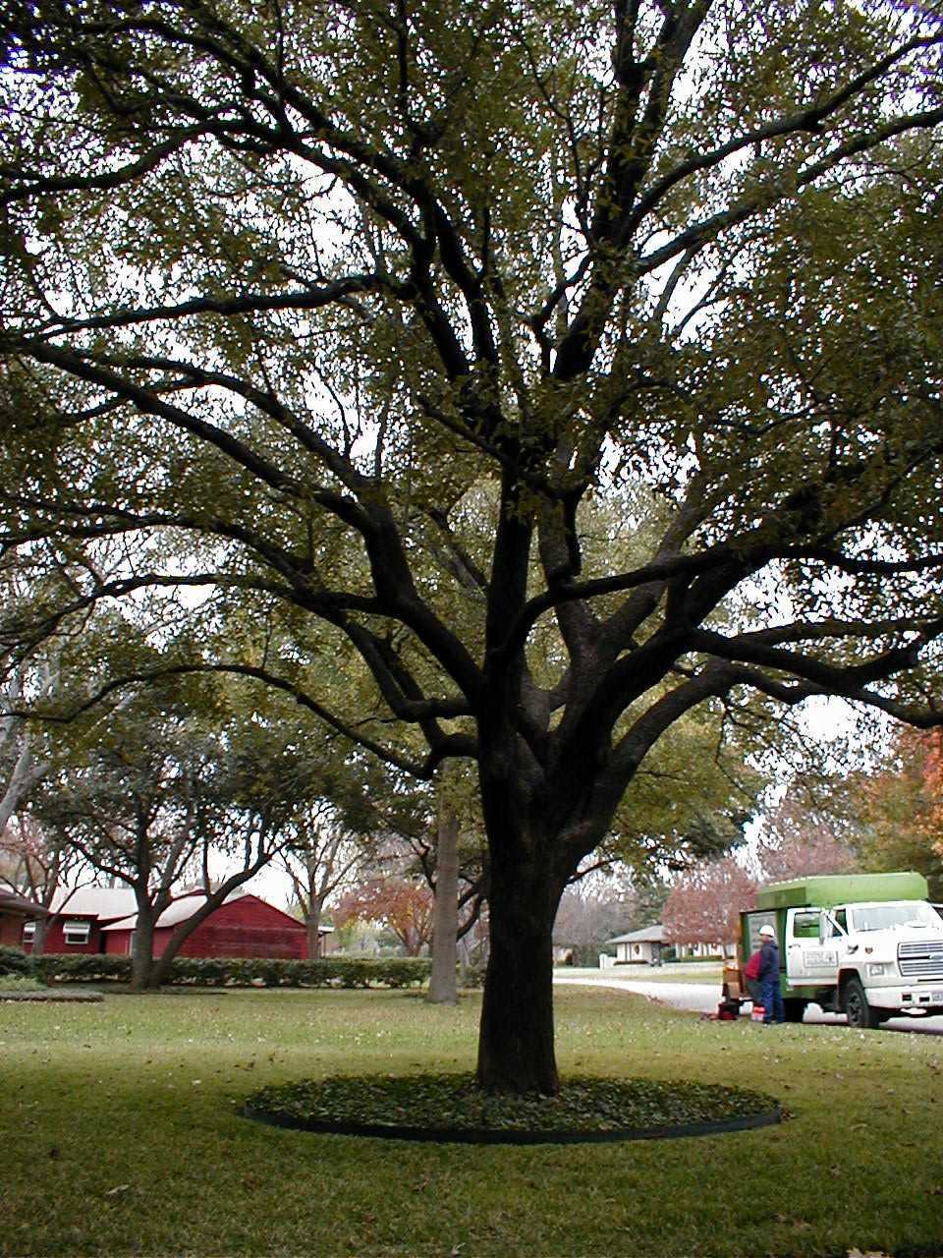
Pruning Types and Terminology
Class 1 pruning is the removal of deadwood down to a given size, broken limbs, and all structural pruning required
Other more descriptive terms can be added, such as crown thinning or crown reduction

Slide 41
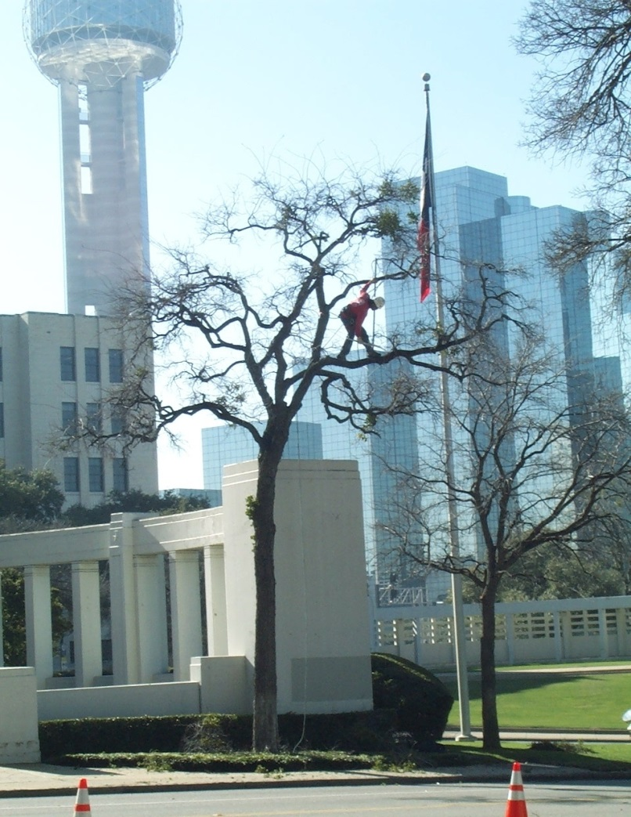
Pruner Qualifications
If a limb is over 3 inches in diameter, or you need a ladder, chainsaw, or long pole saw; it is best to leave the work to a trained arborist.

Slide 42
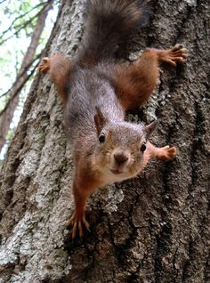
Wood is Heavy
A 12 inch long Live oak log that is an average of 10 inches in diameter, weighs 41 pounds.
Increase the diameter by 2 inches to 12 inches in diameter, and the weight increases to 60 pounds.

Slide 43
Weight of Common Species

Slide 44
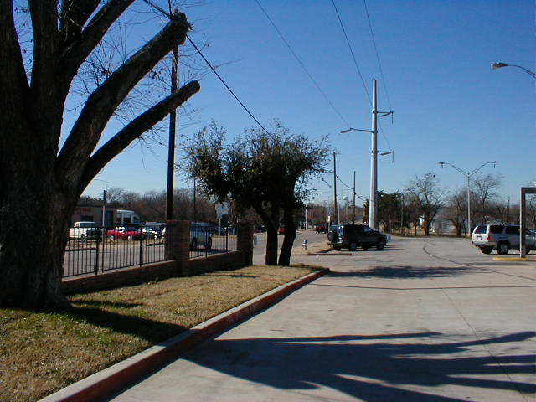
Word to the Wise
If you want to prune your own trees, stay away from power lines!!

Slide 45
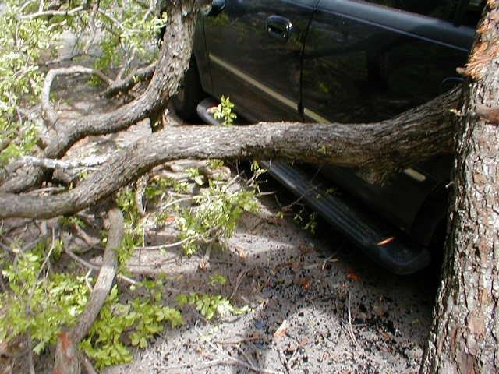
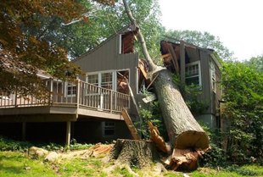
Word to the Wise
Also, limbs can fall in ways that are unexpected, causing damage or injury.

Slide 46
Word to the Wise

Slide 47
Avoid Tired Head!!
To avoid power point “tired head”, we included a glimpse of the 2017 Hooters Calendar!

Slide 48
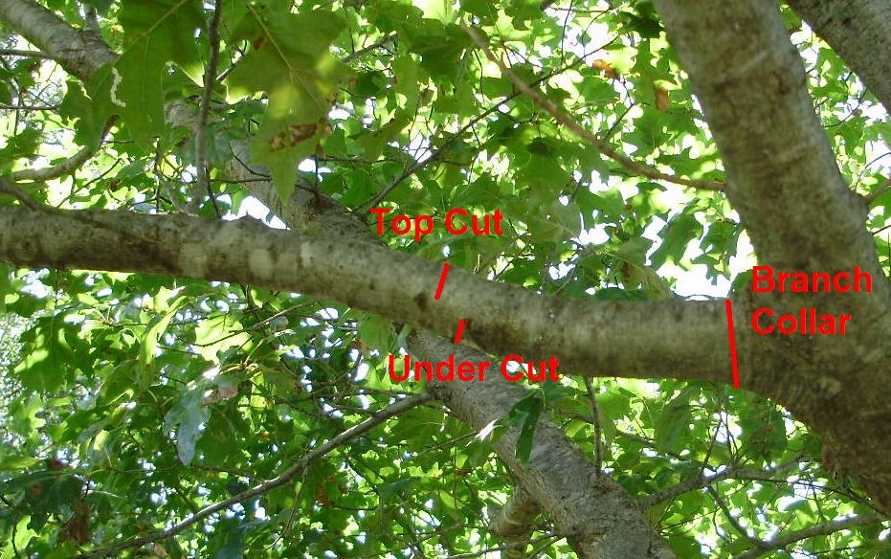
How to Prune
Weight must be removed from larger limbs before making a final cut.
Although called the three cut method, larger limbs require more than three cuts in order to remove the weight in stages.

Slide 49
How to Prune
Property owners can usually remove deadwood or broken limbs on smaller trees, but they may not understand how to remove limbs with poor attachment angles, uneven spacing, or crossing limbs (agitators).

Slide 50
How to Prune
A properly pruned tree does not look “pruned” from a distance.

Slide 51
How to Prune
Before Pruning
After Pruning

Slide 52
How to Prune- Before

Slide 53
How to Prune- After

Slide 54
How to Prune- Before

Slide 55
How to Prune- After

Slide 56
How to Prune- Before

Slide 57
How to Prune- After

Slide 58
How to Prune
A properly pruned tree does not produce a large amount of epicormic sprouts (or “suckers”), as when the tree’s upper canopy is thinned too heavily.
Over pruning a tree to allow more sunlight to the turf causes the tree to quickly generate a large amount of foliage- mostly epicormic sprouts.

Slide 59
How to Prune
It is better to move the turf outward as the tree grows and replace the turf with shade tolerant plants.

Slide 60
How to Prune
Research shows that wound dressings slow the compartmentalization process.
However, if a pathogen is found to be a local problem, wound dressing may be required.
Avoid thick, tar-like dressing and use a light coat of aerosol paint, amber shellac or lac balsam.

Slide 61
How to Prune
A few pathogens can be spread by pruning tools and tools may require sterilizing between trees, or sometimes between cuts.
Disinfectants are commercially available. You can also mix water with 10% bleach to disinfect.
After cleaning, oil your tools.

Slide 62
How to Prune
190 proof alcohol also works…however it seems to be a waste of good resources.
Also, alcohol is for disinfecting the tools… not for disinfecting the pruner!!

Slide 63
How to Prune
Topiary
Espalier
Bonsai
Alee’
Fruit Tree Pruning

Slide 64
How to Avoid Mistakes
Never “top” a tree because all re-growth is structurally weak.

Slide 65
How to Avoid Mistakes
Avoid the ever popular “poodle cut”!

Slide 66
How to Avoid Mistakes
My turf is growing just fine!

Slide 67
How to Avoid Mistakes
The industry calls this “lion tailing” because all that is left is a little tuft of foliage on the end.

Slide 68
Pruning Types
Crepe myrtles grow differently compared to other ornamental trees.
Just remember…only you can stop Crepe Murder!!

Slide 69
George Washington, born 279 years ago, admitted to chopping down his father's favorite cherry tree…
(painting by Grant Wood)

Slide 70
Pruning Tools
Safety glasses
Long pants & long sleeves
Work boots with non slip soles that cover the ankle
Hard hat (required in our industry)
Ear plugs or ear phones

Slide 71
Pruning Tools
Hand clippers
Hand saw
Pole saw
Hand or pole lopper
Sheers

Slide 72
Pruning Tools
Chainsaw- the most dangerous hand tool ever invented…
Chainsaw on a stick?

Slide 73
Pruning Tools
The use of a chainsaw requires proper training by experts…
Yeah…I noticed the lack of a hard hat right away, too…

Slide 74
Before I go dormant…are there any questions?
Steve Houser
Steve.Houser@dallastrees.org

